Slide 1
Google Maps and its Implementation

Slide 2
How Google Maps work?
The View
Buildings extracted from satellite view
Places extracted using street view and local guides
Areas of interest is derived from buildings and street view data.
The Direction
The Prediction
Using GPS data extracted from mobile devices. (Via crowdsourcing)
Past traffic data.

Slide 3
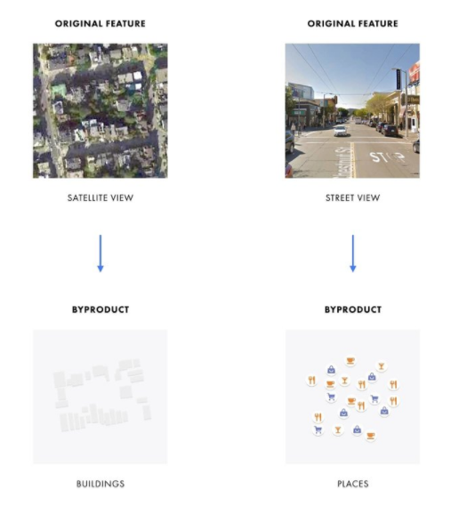
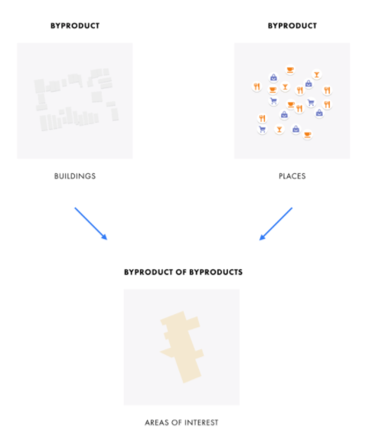
How Google Maps Work?

Slide 4
Street View
Enables OCR to read characters from sign boards.
Latest Google algorithm uses a combination of CNN and RNN to identify each character in the sign board.

Slide 5
Superintelligent AI
Increase Human Intelligence.
Elon Musk’s Neuralink

